Slide 1

Biology for Engineers
21BE45
Prof. Bhanu Revathi K.
Assistant Professor
Department of Biotechnology
Dayananda Sagar College of Engineering
Bangalore
bhanu-bt@dayanandasagar.edu

Slide 2
Unit 5 Bioremediation: Definition and Principles Bioremediation is defined as a process that utilizes microorganisms, green plants, and their enzymes, to remove, degrade, and detoxify the environmental pollutants like heavy metals and hazardous environmental waste into less toxic forms during the treatment of contaminated sites The bioremediation process has been used to reduce the concentration and toxicity of various chemical pollutants, such as pesticides, poly-aromatic hydrocarbons, nitroaromatic com-pounds, heavy metals, and industrial solvents

Slide 3

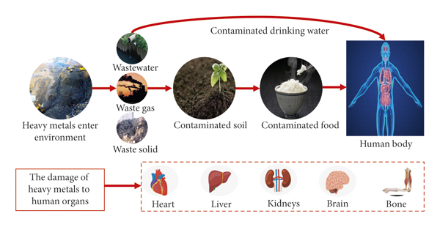












Biology for Engineers UNIT 5: Bioremediation and Biomining via microbial surface adsorption
Heavy metals are defined as metallic elements that have a relatively high density compared to water (>5 gm/cc)
Various public health measures undertaken to control, prevent and treat metal toxicity occurring at occupational exposure, accidents and environmental factors.
They replace essential elements in our body and cause increase in free oxygen radicals.
Some are even cancer causing (As, Pb, Cd) and endocrine disruptors

Slide 4

The principle of bioremediation is based on capabilities of certain microorganisms to break down and degrade environmental contaminants.
The process involves the following key elements:
1. Contaminant Utilization: Bioremediation relies on specific microbes that can use contaminants as a source of food and energy.
The microorganisms have the ability to metabolize and transform pollutants, such as oil, solvents, and pesticides, into simpler, less harmful substances.
Conversion: The selected microbes consume the contaminants and convert them into harmless byproducts.
This conversion process reduces the toxicity and concentration of the contaminants, effectively cleaning up the polluted site.
Optimal Conditions: Helps to grow microorganism in contaminated sites

Slide 5






Types of Bioremediation
Biostimulation: Involves the enhancement of bioremediation by stimulating the growth and activity of indigenous microorganisms
In Situ Bioremediation: In situ bioremediation refers to the treatment of contaminated materials directly at the site where they are located. It avoids the need for excavation or removal of the polluted materials
Ex Situ Bioremediation: Ex situ bioremediation involves the removal of contaminated materials from their original location and their treatment at a different location.
Phytoremediation
Phytoremediation decontaminates polluted soils. This technique utilises physical, chemical, biological, microbiological, and biochemical plant interactions to reduce the toxicity of pollutants at contaminated locations.

Slide 6
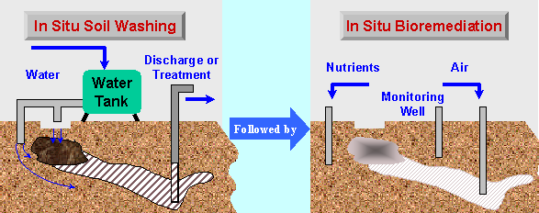
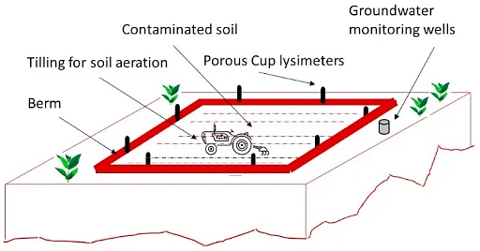
Insitu / Ex situ bioremediation
ex situ bioremediation

Slide 7
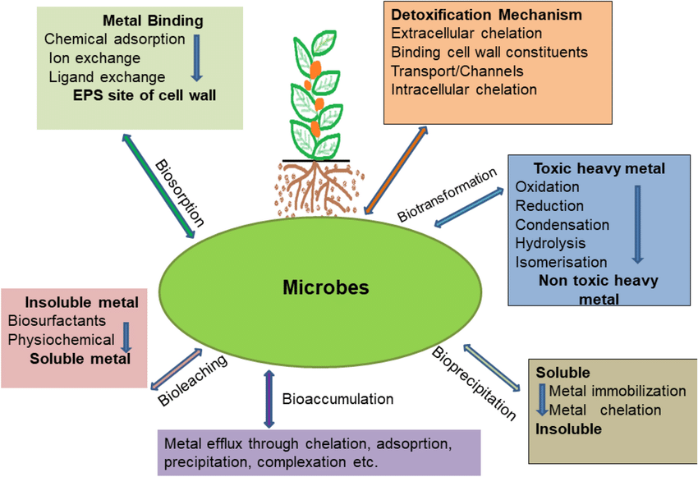


Biology for Engineers UNIT 5: Bioremediation and Biomining via microbial surface adsorption

Slide 8
Microorganisms used in bioremediation
Bacteria, fungi, algae, and yeast.
Mechanism of Bioremediation
The process of bioremediation takes place through various mechanisms
Like
Oxidation & redox process,
Adsorption,
Complexation,
Ion-exchange,
Precipitation,
Electrostatic attraction.
Microorganisms may initiate metal mobilization/immobilization by redox reactions;

Slide 9

















Biology for Engineers UNIT 5: Bioremediation and Biomining via microbial surface adsorption
Algae for bioremediation: Microalgae (The four groups of micro-algae are diatoms, green algae, golden algae and blue-green algae (cyanobacteria)) and Macroalgae (sea weeds)
Bacteria – cell wall components such as peptidoglycan and teichoic acid and lipid layers cause adsorption.
Fungi -cell wall is comprised of chitin, cellulose, b-glucan, a-glucan, chitosans, polyuranides, glucoproteins, lipids, inorganic salts and pigments

Slide 10
Biomining via microbial surface adsorption
Bio-mining ( or bioleaching ) is a process in mining and biohydrometallurgy (natural processes of interactions between microbes and minerals) that extracts valuable metals from a low-grade ore with the help of microorganisms such as bacteria .

Slide 11



Biology for Engineers UNIT 5: Bioremediation and Biomining via microbial surface adsorption
Direct v. Indirect Bioleaching
Direct bioleaching uses minerals that are easily receptive to oxidation to create a direct enzymatic strike using the microorganisms to separate the metal and the ore.
In indirect bioleaching, microorganisms are not in direct contact with minerals during the process. However, leaching agents are created by microbes, which still oxidise the ore.
Commercial metal extraction is a quicker process optimized through humidity, potential hydrogen (pH), temperature, and chemical elements.

Slide 12










Biology for Engineers UNIT 5: Biomining via microbial surface adsorption
The 3 most common commercial biomining processes are:
1. Slope Leaching: Fine ore is kept in a large, slope-shaped dump. A solution made of inoculum is continuously sprayed over the ore. After that, the leach liquor (or remaining liquid) is gathered at the bottom and processed for supplemental metal recovery.
2. Heap Leaching: In this technique, the ore is arranged in large heaps. An aqueous mixture of microorganisms is sprinkled over the leach pile. Then, the solution is collected and processed to help recover even more metal.
3. In-situ Leaching: The ore remains in its natural state while the leaching process takes place. Water that contains Thiobacillus bactrerium is pushed through drilled passageways within the ore. The leach fluid is then stored until it is time for metal recovery.

Slide 13





Mechanism of Microbial surface -adsorption of metals
Biosorption is defined as “ability of biological materials to accumulate heavy metals from wastewater with the help of energy or physicochemical pathways of uptake (not at the cost of ATP)
1. Metabolic dependent biosorption
Microbial cell wall contains certain metallic proteins binds to specific metals and adsorption takes place with the help of ATP energy
In some other microbial cells metal chelating substance that are exist in cell wall and chelate ( bind) to specific metals during adsorption using ATP energy
2. Metabolic Independent biosorption
Here biomass like dead microbial cells are involved for metal adsorption with out energy by ATP
The adsorption process can be ionic interactions or physiochemical adsorption.
Presence of anionic ligands on bacterial cell wall (carboxyl, amine, hydroxyl, phosphate, and sulfhydryl groups) also plays an important role in metal biosorption.

Slide 14


Process of physical adsorption at cell wall
There are pathways for surface adsorption, (i) rapid physical adsorption and (ii) electrostatic adsorption.
Electrostatic interactions between metals in liquids and the cell walls of bacteria ,algae, fungi, and yeast aid in the biosorption of cadmium, uranium, copper, zinc, and cobalt.

Slide 15
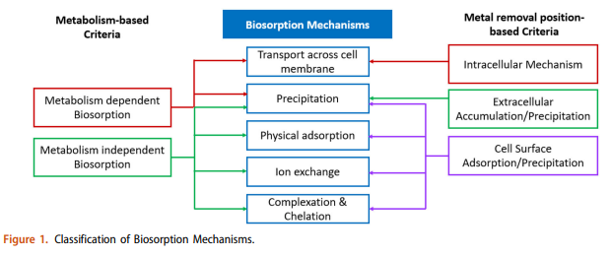
Biology for Engineers UNIT 5: Bioremediation and Biomining via microbial surface adsorption

Slide 16









Biomining via microbial surface adsorption
Thiobacillus ferrooxidans is a chemophilic, moderately thermophilic bacteria which can produce energy from oxidation of inorganic compounds like sulfur and iron and helps in bioleaching
Thermothrix thiopara is an extremely thermophilic bacteria that can survive very high temperatures between 60-75˚C and is used in extraction of sulfur.
Example of Biosorption ( removal )of metals by Bacteria
Arsenic = Bacillus sp.
Cadmium = Enterobacter, Micrococcus
Lead = Micrococcus, Bacillus .
Mercury = Enterobacter

Slide 17


Biology for Engineers UNIT 5: Bioremediation and Biomining via microbial surface adsorption
Some advantages of bioleaching include:
Bioleaching can stabilise sulphate toxins from the mine without causing harm to the environment.
Poisonous sulfur dioxide emissions harm the environment and can cause health problems for miners, and bioleaching avoids this process entirely.
Bioleaching is more cost-effective than smelting processes.
Some Bioleaching offers a different way to extract valuable metals from low-grade ores that have already been processed.

Slide 18
What are the environmental risks of biomining?
Leakage and treatment of the acidic, metal-rich solution created by the microbes, similar to the acid mine drainage from some abandoned mines. Need for waste treatment protocols
Egs: Chile- Cu from ores
Europe- Fe, Co
UAE- gold mining ; Other minerals- Silver, Uranium, Nickel and Zinc

